Slide 1
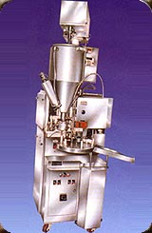
Reduction of Waste generation in
Solvent Paint Department
by
Ganesh Babu Pavalarajan
Six-Sigma Project Presentation
University of Nebraska-Lincoln

Slide 2
Presentation Outline
Company Background
Problem Definition
Measure
Analyze
Improve
Control

Slide 3
Introduction- Company Background
INTRODUCTION
PREFACE
DEFINE
MEASURE
ANALYZE
IMPROVE
CONTROL
PATH FORWARD
Asian Paints (India) Ltd. - One of the top ten
decorative manufacturers in the world
Turn over- $435 Million
17 Manufacturing plants across the world
Joint venture – Pittsburgh Paints and Glass
Industries (PPG), USA
ISO-9001 and ISO-14001 certified

Slide 4
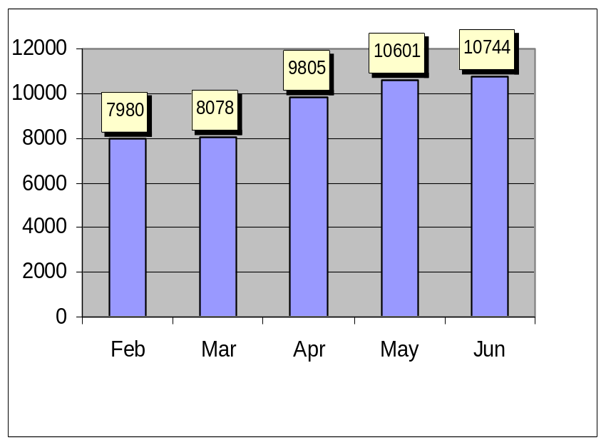
Preface
INTRODUCTION
PREFACE
DEFINE
MEASURE
ANALYZE
IMPROVE
CONTROL
PATH FORWARD
Increase in Customer complaints
No. of Waste container generation
Environmental restrictions
Load on Effluent Treatment Plant
Man power overheads
Re-cycle of paints
Validation process
No. of Waste containers generated
from Feb-02 to Jun-02
DPMO 78,683
Process Sigma 2.91

Slide 5
Preface
INTRODUCTION
PREFACE
DEFINE
MEASURE
ANALYZE
IMPROVE
CONTROL
PATH FORWARD
Critical to Quality: Number of Waste Containers (tins) Scrapped
Customer: Marketing and Environment Management Cell
Goal: 75% reduction in Packing Material Wastage
Benefits
Savings of about $ 115,400 per annum
Reduced Environmental Pollution
Effective resource utilization
Good House Keeping

Slide 6
Define
INTRODUCTION
PREFACE
DEFINE
MEASURE
ANALYZE
IMPROVE
CONTROL
PATH FORWARD
Macro Statement:
Reduction of Waste container generation in
Solvent Paint Department by 75%
Response Variable:
Data of Waste Containers report from
Environmental Management System
Data Response Period:
Once in a month

Slide 7
Define
INTRODUCTION
PREFACE
DEFINE
MEASURE
ANALYZE
IMPROVE
CONTROL
PATH FORWARD
Extent:
Supplier Defects
Incorrect Work Practices
An average of 12.7 tins per tonnes of production was scrapped between Feb to June 2002
Average of 9442 tins per month
Accumulation of Waste Containers on Shop Floor
DPMO - 78,683
Process Sigma - 2.91

Slide 8
Define
INTRODUCTION
PREFACE
DEFINE
MEASURE
ANALYZE
IMPROVE
CONTROL
PATH FORWARD
Time Frame:
July-02 to Dec-02
Specification:
Container wastage should come down to 3.17 tins
per tonnes of Production

Slide 9
Measure
INTRODUCTION
PREFACE
DEFINE
MEASURE
ANALYZE
IMPROVE
CONTROL
PATH FORWARD
Process Flow Diagram for Paint Manufacturing
Paint
Packing Line
Paint Filling Machine
Operation
Container Lidding machine
Operation
Receipt of
Packing. material
Waste
Paint Packing
Finished Goods
Storage Room
Stacking on
the Pallet
Paint Processing
Additives Mixing
Paint Processing
machine
Pigments
Grinding
Batch Approval by
Q.C

Slide 10
Measure
INTRODUCTION
PREFACE
DEFINE
MEASURE
ANALYZE
IMPROVE
CONTROL
PATH FORWARD
Process Flow for Defective Container
Processing
Section
Generation of defects
during packing
Red
bins
Packing
Transfer of waste container to
Storage Area
Scrap Yard
Cleaning of containers using
Mineral Turpentine Oil

Slide 11
Measure
INTRODUCTION
PREFACE
DEFINE
MEASURE
ANALYZE
IMPROVE
CONTROL
PATH FORWARD
Functional Deployment Matrix
KPOVS | Defective Containers | Re-cycling of paint | Load on Effluent Treatment plant |  | Man power overhead | Validation process | CPR X Effect |  | Rank
CPR | 10 | 5 | 3 |  | 4 | 8
KPIVS
Vendors | 10 |  |  |  |  | 8 | 164 | III
In-process generation | 5 | 7 |  | 8 | 5 |  | 139 | V
Machines | 10 | 9 |  | 7 | 8 | 5 | 238 | I
Operators | 9 |  |  |  | 7 | 6 | 196 | II
Packing returns | 7 | 8 |  |  | 8 | 2 | 158 | IV

Slide 12
Measure
INTRODUCTION
PREFACE
DEFINE
MEASURE
ANALYZE
IMPROVE
CONTROL
PATH FORWARD
Constraints
  Data of Supplier defects was Incomplete
  Data of Machines used was not available
  Data of Operators Deployed was not available
  Data of In-process generation was not available
  Fresh generation & Old accumulation were mixed up
Formats designed & introduced to collect accurate data of all KPIVs SAMPLE

Slide 13
Cause and Effect Diagram
INTRODUCTION
PREFACE
DEFINE
MEASURE
ANALYZE
IMPROVE
CONTROL
PATH FORWARD
Materials
Men
Supplier Defects
Lack of knowledge
Customer Returns
In-proper operation
In-proper Handling of finished product
Packing Returns
Waste container generation
Paint spill on lid
In-process Sampling
Over flows
Packing
Lid fitment problem
Methods
Machines

Slide 14
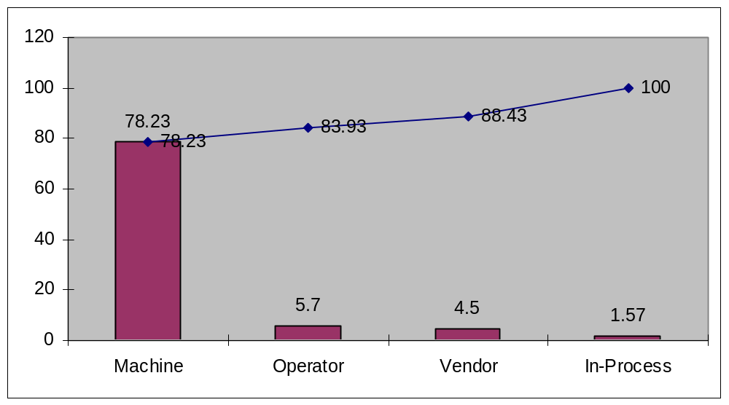
Pareto Analysis
INTRODUCTION
PREFACE
DEFINE
MEASURE
ANALYZE
IMPROVE
CONTROL
PATH FORWARD

Slide 15
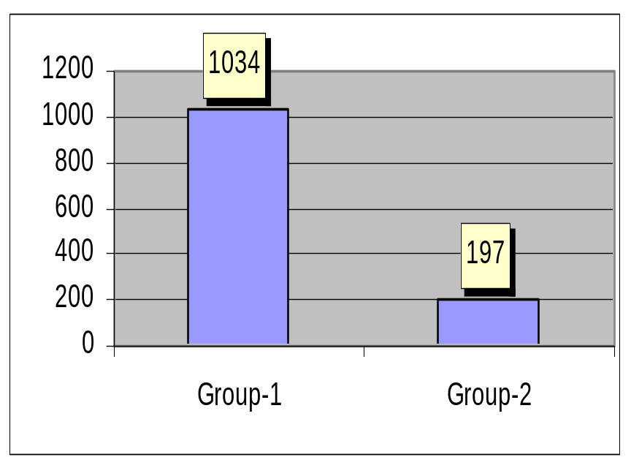
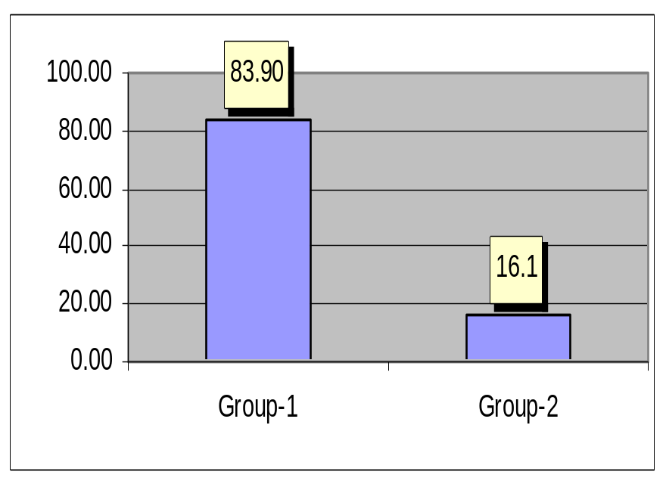
Defects in Machines
INTRODUCTION
PREFACE
DEFINE
MEASURE
ANALYZE
IMPROVE
CONTROL
PATH FORWARD
Average no. of defective containers in a month
Percentage defective containers
Group-1 contains 7 Filling Machine
Group-2 contains 5 Filling Machine

Slide 16
Design of Experiments
INTRODUCTION
PREFACE
DEFINE
MEASURE
ANALYZE
IMPROVE
CONTROL
PATH FORWARD
Key Parameters in Group-1 Filling Machine
Shut-off valve angle in Degrees
Paint Viscosity in saybolt viscometer seconds
Feed Rate in tins/minute
3 x 3x 3 Factorial design with 3 replications
Filling machine
Valve angle
Paint viscosity
Feed rate
30 Deg.
30 sec
50 tins/m
37.5 Deg
35 sec
55 tins/m
45 Deg.
40 sec
60 tins/m

Slide 17
Anova
INTRODUCTION
PREFACE
DEFINE
MEASURE
ANALYZE
IMPROVE
CONTROL
PATH FORWARD
Source DF Squares Mean Square F Value Pr > F
Model 18 61354.51852 3408.58436 320.98 <.0001
Error 62 658.39506 10.61928
Corrected Total 80 62012.91358
R-Square Coeff Var Root MSE Container Defects Mean
0.989383 5.701006 3.258723 57.16049
Source DF Type I SS Mean Square F Value Pr > F
Valve angle 2 50985.35802 25492.67901 2400.60 <.0001
Viscosity 2 52.02469 26.01235 2.45 0.0946
Feed Rate 2 8789.06173 4394.53086 413.83 <.0001
Valve angle*Viscosity 4 41.75309 10.43827 0.98 0.4235
Viscosity*Feed Rate 4 212.04938 53.01235 4.99 0.0815
Valve angle*Feed Rate 4 1274.27160 318.56790 30.00 <.0001
From the anova table - valve, feed rate and its interaction plays significant role for 0.05 Level of significance

Slide 18
Waste generation Phenomenon
INTRODUCTION
PREFACE
DEFINE
MEASURE
ANALYZE
IMPROVE
CONTROL
PATH FORWARD
Shut-Valve (Pneumatically operated) does not prevent paint drippage resulting spillage of paint over the tin lids causing defective container
Valve Angle cause paint drip
Paint Feed
PAINT DRIP
CAUSE DEFECTIVE TIN
Valve angle (45 degree) avoids drippage found from DOE , and confirmed with Group-2 filling machine

Slide 19
Improvements
INTRODUCTION
PREFACE
DEFINE
MEASURE
ANALYZE
IMPROVE
CONTROL
PATH FORWARD
Group-1 Machines shut-off valve angle were modified to 45 degree
Standard Operating Procedures (SOP) for the Filling machines and process are framed, and the feed rate of the machine fixed at 55 tins/minute
Segregation of good containers and returns in the shop floor

Slide 20
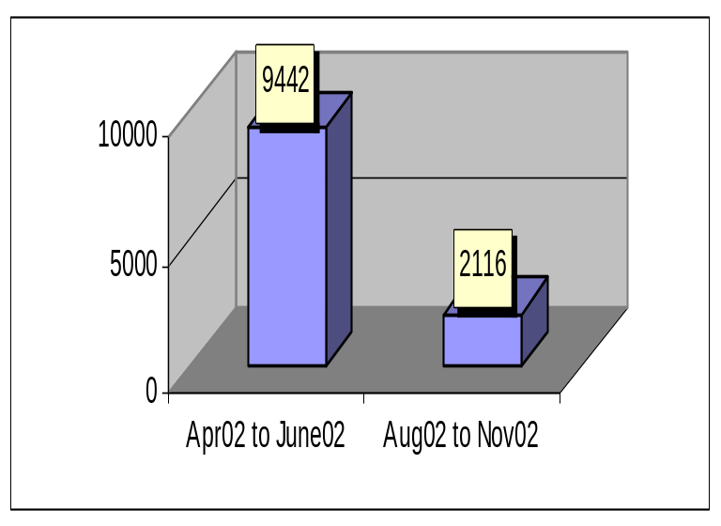
Improvements
INTRODUCTION
PREFACE
DEFINE
MEASURE
ANALYZE
IMPROVE
CONTROL
PATH FORWARD
No. of Waste tins generated per month
Wastage reduced to 3 tins per tonnes average Aug02 –Nov02
Savings of $115,400 per annum
DPMO- 17,633
Process Sigma- 3.61
Cost Benefits
Savings of paint and containers $ 70,230 per annum
Savings of Man power overheads $ 15,000 per annum
Savings from Re-cycling cost , Effluent Treatment & Validation $ 30,170 per annum

Slide 21
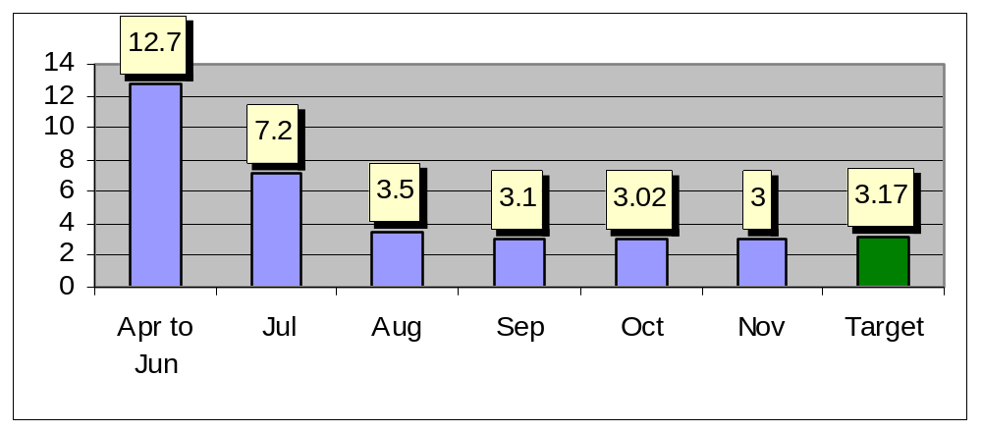
Improvements
INTRODUCTION
PREFACE
DEFINE
MEASURE
ANALYZE
IMPROVE
CONTROL
PATH FORWARD
Number of Tins Scrapped per tonnes of Production

Slide 22
Control Plan
INTRODUCTION
PREFACE
DEFINE
MEASURE
ANALYZE
IMPROVE
CONTROL
PATH FORWARD
Established Preventive maintenance for shut-off valve alignment once a week
Filling Machine’s Feed rate is set to 55 tins/minute with help of Programmable Logic Circuits (PLC) and included in the SOP.
Scheduled Predictive Maintenance to check the shut-off valve angle (Wear Rate )
Suppliers penalized for delivering defective containers
Deployment of skilled operator
Sectional Performance Graphs display to Educate Supervisors & operator on waste generated.

Slide 23
Alternative Control Plan
INTRODUCTION
PREFACE
DEFINE
MEASURE
ANALYZE
IMPROVE
CONTROL
PATH FORWARD
Suggested usage of Hardened steel to reduce the wear rate of valve
Suggested Lapping of valves during preventive maintenance
Suggested to upgrade the filling cylinder to servo mechanism instead of pneumatic operated cylinder
Training to operators once in six months
Quarterly Audits on filling machine

Slide 24
Path Forward
INTRODUCTION
PREFACE
DEFINE
MEASURE
ANALYZE
IMPROVE
CONTROL
PATH FORWARD
Elimination of containers defects
Achieving Six-Sigma process level
Sustenance of improvement with respect to defects from Vendor
Replacement of Semi-automatic Filling Machine

Slide 25
Comments
?

Slide 26
Sample Format for Data Capture
Vendor Defect
Date of Supply | Supplier | Order.No | Batch.Size | Brand Name | No. of Defects
Machine and operator Details
Date | Shift | Filling Machine No. | Operator Name | Brand Name

